Slide 1
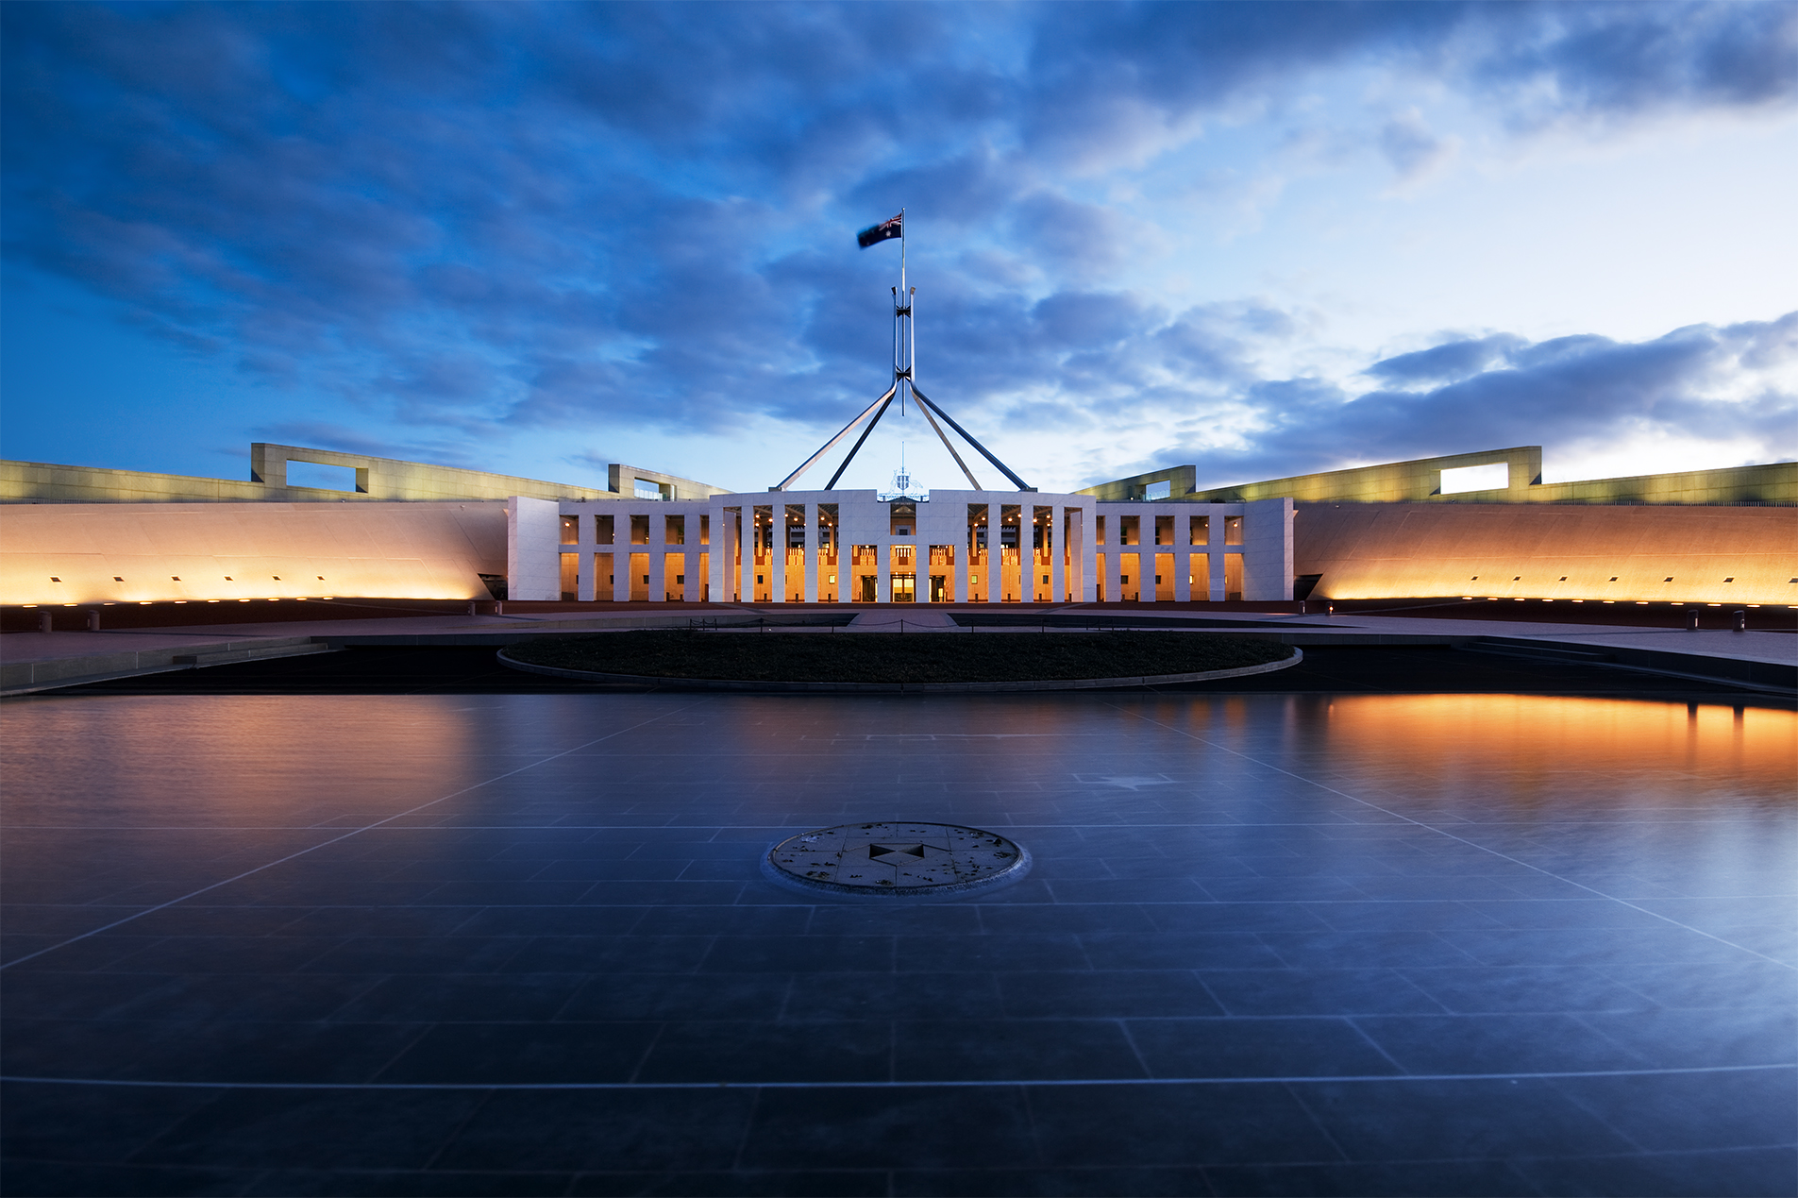
Year 11: Politics & Law

Slide 2
Syllabus Dot Point
The court hierarchy, methods of statutory interpretation and the doctrine of precedent.
Notes:
Chapter 6

Slide 3
Types of Laws Recap
Superior law
Constitution
Ordinary law
Statute law
Common law
Subordinate law
Delegated legislation
Notes:
Definition & example

Slide 4
Ch. 3: The Judiciary
S.71: Judicial power and Federal courts
S. 72: Judges’ appointment, tenure and remuneration
S. 73: Appellate jurisdiction of High Court
S. 75: Original jurisdiction of High Court
S. 76: Additional original jurisdiction
S. 80: Trial by jury
Notes:
Note: s. 80 = prescribed right (rights/freedoms)

Slide 5
Federal Court Hierarchy
High Court of Australia
Highest Court of appeal
Power to interpret the Constitution
Court of Disputed Returns
Federal Court of Australia
Federal Court of Australia Act 1976 (Cth)
Family Court of Australia
Family Law Act 1975 (Cth)
Federal Circuit Court of Australia
Federal Magistrates Act 1999
Renamed in 2013

Slide 6
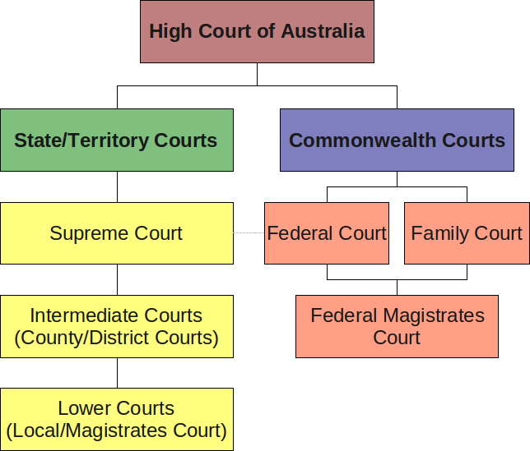

Slide 7
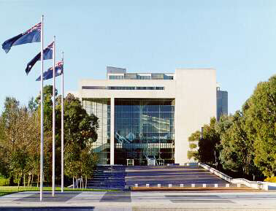
The High Court of Australia

Slide 8
State Court Hierarchy
Supreme Court of Western Australia
Court of Appeals Division
General Division
Family Court of Western Australia
District Court of Western Australia
Criminal division
Civil division
Magistrates Court of Western Australia
Criminal division
Civil division
Specialized Courts

Slide 9
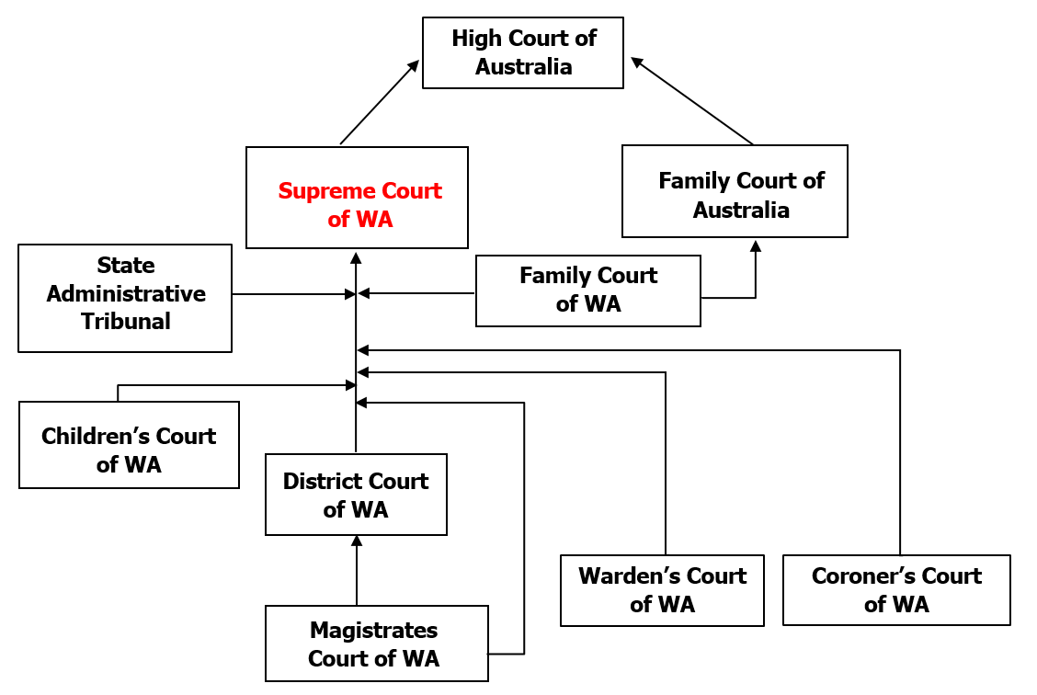

Slide 10

Syllabus Dot Point
The court hierarchy, methods of statutory interpretation and the doctrine of precedent.
Notes:
Chapter 6

Slide 11
Statutory Interpretation
Interpretation most often is necessary because the meaning of an Act is unclear. These problems arise from:
Drafting problems
Inconsistencies and contradictions
Words and definitions are unclear/badly defined
ambiguity or vagueness
Time and changing circumstances
Discussion question:
In theory, statutes should be clear and unambiguous after such a rigorous process. Therefore, it begs the question – how are mistakes made?
Notes:
Answer: Executive dominance tactics – gags, guillotines, floodgating

Slide 12
Statutory Interpretation
In futuro
‘In the future’
Prospective
Statute laws are made as rules to guide future actions or events
Therefore, cannot be back dated
They act to guide the law form their date of proclamation
In contrast to common law which is ex post facto
Ex post facto
‘After the fact’
Retrospective
Judgements made by the courts are done so after the dispute has occurred
Therefore, judges cannot go out in search of a case to try
Note: Unchallenged legislation

Slide 13
Judicial Activism
Question: What is the scope of a judges role?
Judges ARE limited in their ability to interpret statutes
Statutes always have precedence over judge-made law
Courts are unable to change the law
A case must be brought to the court before judges can interpret statutes
Judges ARE NOT limited in their ability to interpret statutes
Judges may need to interpret the meaning of words in an Act in order to apply them to specific situations before the courts
Due to drafting problems, inconsistencies and contradictions
Judges may refer to international law and judgments of domestic, foreign and international courts relevant to human rights
E.g.: Mabo Case No. 2, 1992
Notes:
https://www.lawsocietywa.asn.au/wp-content/uploads/2015/10/2016APR-Statutory-Interpretation-Student-Resource.pdf

Slide 15
Appeals
The process of interpreting legislation is complex and can often be the subject of an appeal
Definition:
A review of a court case by a higher court
A form of judicial accountability exercised by courts over other courts
The Judiciary Act 1903
The statute which sets out the legal framework for the courts
s.35A – sets out the circumstances under which a so-called Special Leave to Appeal may be granted
A miscarriage of justice;
A questions of law, which creates the possibility that new common law may be made – i.e. a new precedent may be set; and
A conflict between courts

Slide 16
Statutory Interpretation
Courts approach statutory interpretation using 3 different rules:
1. Literal Rule
2. Golden Rule
3. Mischief Rule / Purpose Rule

Slide 17
Rules of Interpretation
Literal rule
A rule of statutory interpretation in which the courts apply the standard dictionary definition of a word in a statute
The courts are to use the ‘ordinary’ meaning of the language within the statute
Also known as the ‘plain meaning rule’
To give statute’s words their literal meaning regardless of whether the result is sensible or not
Application of the literal rule may lead to unexpected or absurd results!

Slide 18
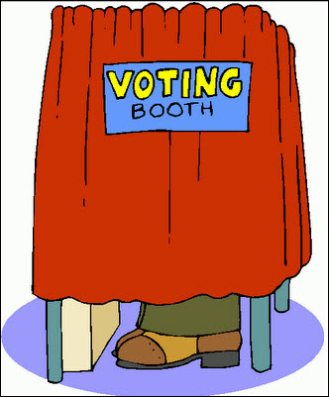

A ‘literal’ case
Whiteley v Chappell (1868): Wording of the Act says it is an offence to impersonate ‘any person entitled to vote at an election.’
The defendant attempted to vote in the name of a deceased person.
A dead person isn’t entitled to vote
Held:
No offence as the phrase does not include dead people – judge took a literal approach to the case

Slide 19

Another ‘literal’ case
London and North Eastern Railway v Berriman (1946)
Railway companies are under a duty to provide a look-out man when ‘repairing or relaying’ the track. V died when oiling the railway line. V’s widow was not successful as according to the Fatal
Accidents Act 1846 , oiling was
maintenance and not repair
work.
This was an unjust result

Slide 20
Rules of Interpretation
Where there is more than one dictionary meaning and the literal rule cannot provide a solution, another interpretation rule or aid is needed...
Golden rule
A rule of statutory interpretation in which the courts seek alternative meanings of a word in a statue if the literal meaning results in absurd or unjust outcomes
Exception to the Literal rule
Will be used where the literal rule produces the result where Parliament’s intention would be circumvented rather than applied (to avoid absurdity and inconsistency – but no further)
The judge looks to the intention of the law.

Slide 21
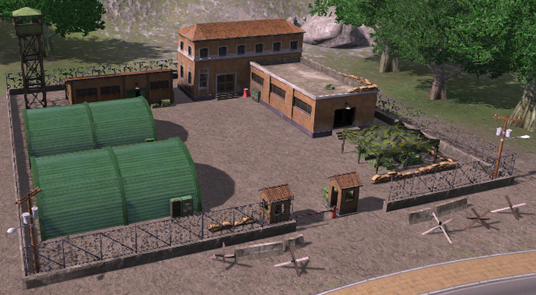
A ‘Golden Rule’ case
Adler v George (1964) – the defendant was charged under the Official Secrets Act 1920 with obstructing a member of the armed forces on security patrol ‘in the vicinity of a prohibited place’. The defendant argued that he was actually in the prohibited place, not in the vicinity of it – that is, near to it.
Held: Court interpreted the phrase to include ‘in’ a prohibited place to avoid the absurd result.

Slide 22
Rules of Interpretation
Mischief rule
A rule of statutory interpretation in which the court seeks the original purpose of a statute law
The courts looks at the gap in the law or the ‘mischief’ which Parliament had felt it necessary to fill when passing the Act
This rule is used if the meaning cannot be declared without absurd or unjust outcomes using the literal or golden rules
The courts may refer to the statute’s second reading speech in Hansard, or other materials to seek the purpose of the law
This is sometimes referred to as the ‘purposive’ rule

Slide 23
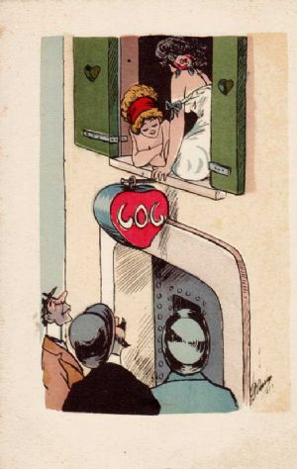
A ‘Mischief’ case
Smith v Hughes (1960)
Under the Street Offences Act 1959 it is an offence to solicit ‘in the street or public place’.
Prostitutes solicited men from a balcony and through a window while in their home.
Court Held: Parker LCJ said that ‘everybody knows that this was an Act designed to clean up the streets’.
Defendants convicted.
Application of the mischief rule avoided the absurd result.

Slide 24
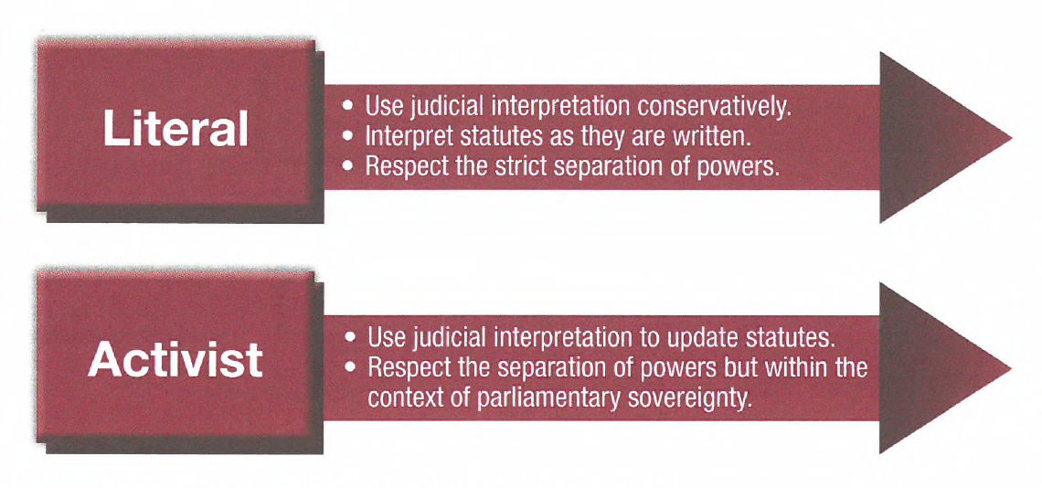
Judicial Discretion

Slide 25

Syllabus Dot Point
The court hierarchy, methods of statutory interpretation and the doctrine of precedent.
Notes:
Chapter 6

Slide 26
The Doctrine of Precedent
The hallmarks of justice are that it should be certain, and should be universal
The doctrine of precedent was developed to provide the necessary certainty and universality
A precedent is a principle of law that is applied to subsequent legal disputes concerning similar matters. The rule that lower courts follow precedents made by higher courts (both in common law judgements and statutory interpretation) ensures consistency while still allowing the law to be modified over time

Slide 27
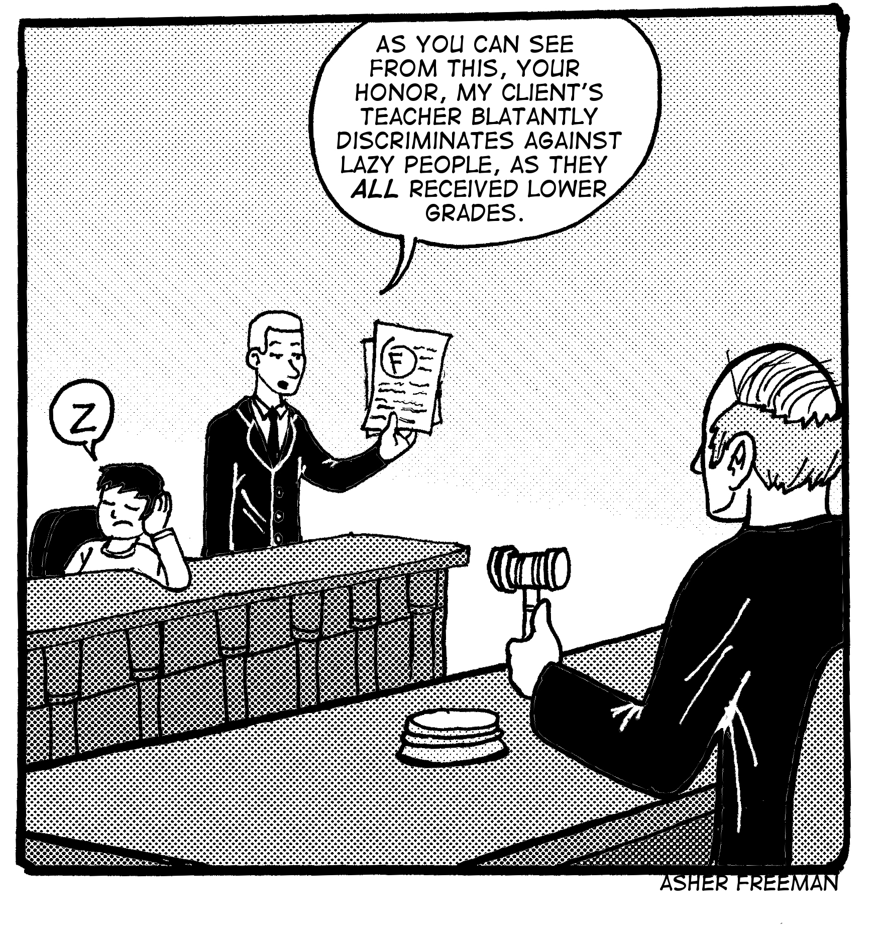

Slide 28
Stare Decisis
At its heart is a very simple principle: the Law expounded in one case should be followed in later, similar cases
Stare decisis results in:
Fairness
Predictability
Consistency
Flexibility
Telstra Corporation v Treloar (2000) 102 FCR 595, per Branson and Finkelstein JJ at 602
“The rationale for the doctrine of precedent is certainty, equality, efficiency, and the appearance of justice”
Queensland v Commonwealth (1977) 139 CLR 585 per Gibbs J
“The need for continuity and consistency in judicial decision making”

Slide 29
Principles of Law
Natural Justice
A principle of justice incorporating the rule against bias and the right to a fair hearing
Fair processes for determining the truth in a dispute
Also known as ‘due process’
Court and tribunals have a duty to act fairly
Rule of law
Everyone is subject to the law
Everyone is equal before the law
The law must be clear and understandable
Habeas corpus
The law must be capable of change – to reflect a changing society
Note: this rule is characterized by a number of other principles such as judicial independence, checks and balances, limited power, respect for rights and freedoms, democratic law making, the coherence of laws and public knowledge of laws

Slide 30
Judicial Reasoning
Judges summarize / explain their decisions in writing and important ones get published in law reports
Law reports
Usually cases that set a precedent as to how other, similar cases will be decided
Law reports are useful as they allow you to research the outcome of previous court cases. This will help you predict arguments used in, and outcome of, current or future cases

Slide 31
Ratio Decidendi
Definition
‘Reason for deciding’
The essential reasoning for the decision in any case
Ratio decidendi forms the basis of the binding nature of the decision from the case that may be applied in future similar cases
The ratio, as it may be known, may be either binding or persuasive, depending upon where the court sits in the hierarchy
The ratio from cases forms the basis of the common law

Slide 32
Obiter Dicta
Definition:
‘Saying by the way’
Things said by a judge in passing or by the way of example during the course of a final judgement
These observations are not an essential part of a judge’s reasoning in reaching a decision and are therefore not a binding part of that decision
They may, however, be helpful when determining whether the ratio coming from that case should be applied to others in future
Obiter is persuasive, not binding….but should not be ignored
May provide some insight or explanation into how the judge interpreted the facts and legal principles, in order to reach his or her decision
Can provide important information and guidance for future judges

Slide 33
So how does it all work?
Courts have two options in a case involving existing case law:
Abide by stare decisis and apply existing case law if it exists; or
Recognize a case is different from any existing case law and create new case law
Note: When judges decide a case where no previous case law applies, they create a precedent
Note: Precedents are not necessarily abrogated by lapse of time…there is no expiry date
Notes:
See handout
Picture: Ex-CJ of WA Supreme Court – Wayne Martin

Slide 34
Binding v Persuasive Precedents
Binding precedent = obliges a court to follow its decision
Persuasive precedent = can influence or inform a decision but not compel or restrict it
The effective functioning of precedent requires three (3) things:
First, it needs a clear and well defined court hierarchy, so the function and status of each court is clear
Second, it needs close adherence to the principle of stare decisis by judges and magistrates
Third, it requires a thorough system of law reporting, so the records about other decision and precedents are available to all judges
This system allows the law to function with consistency, while retaining enough flexibility to accommodate change and development

Slide 35
Binding Precedent
This type of precedent is called a ‘mandatory precedent’ in some court systems
A binding precedent requires ALL inferior courts to follow the ratio decideni of superior courts, when the facts of a case are the same or similar
Note that precedents can only be binding in the same jurisdiction, such as State court hierarchies
Precedents established in the Federal Court, for example, are not binding on court hierarchies in any other the States

Slide 36
Persuasive Precedent
While the decisions of lower courts or courts in other jurisdictions can never be binding, they can certainly influence the decision of a court
Judges can examine the precedents established in these courts for guidance and information
They may study the precedent of an inferior court… OR a court in another hierarchy (the ratio decendi of a South Australia District Court, for example, may provide a persuasive precedent for a judge in the District Court of Western Australia)… OR they may develop a new precedent that is informed or shaped by these persuasive precedents
There may be no scope for a persuasive precedent if there is a binding precedent that must be applied
A court can only choose to follow a persuasive precedent if no relevant binding precedent exists in its own hierarchy

Slide 37
Binding v Persuasive
Overview:
A decision at a higher level in the same hierarchy
Ratio is binding
Obiter is persuasive
A decision at the same level
A judge does not have to follow the decisions of other judges at the same level in the same judicial hierarchy – these decisions will however be highly persuasive in the interests of consistency
A decision in another hierarchy
A decision of a court in a different hierarchy may be of considerable weight, but will not be binding
Notes:
See King page 142

Slide 38
Avoiding or Changing Precedent
Parties to a case who are unhappy with the legal reasoning of court’s judgement can appeal to a higher court and seek a changed decision
Judges in the superior court may take four different actions in changing the existing decision:
Avoid existing precedent by Reversing the decision
Avoid existing precedent by Overruling a case
Avoid existing precedent by Disapproving of the decision
Avoid existing prededent by Distinguishing a case

Slide 39
Research Notes
Use pages 147 – 151 and make notes on the following 4 ways courts create common law and avoid existing precedent (add a bullet point on each of the cases provided to enhance your notes):
Reversing the decision (Wilson v Bauer Media)
Overruling a case (Mabo v QLD No.2)
Disapproving of the decision
Distinguishing a case (Donoghue v Stevenson)

Slide 40
Avoiding or Changing Precedent
Distinguishing (different case/different fact/new precedent) - Donoghue
Judge may avoid following existing binding precedent if he/she can find a difference (distinguish) in the material facts
Reversing (same case/different judgment/new precedent) - Wilson
Higher court hears same case on appeal and decides the lower court made incorrect judgment it will substitute a correct ratio decidendi for the ratio decidendi used by the lower court
Overruling (different case/higher court judgment/new precedent) - Mabo
Higher court decides not to follow precedent (persuasive) set in lower court and in doing so sets a new precedent
Disapproving (different case/follows precedent)
Lower court expresses dissatisfaction with precedent but must follow it
Judgment’s obiter dictum would indicate to superior courts and parliament to consider law reform
The High Court sometimes takes this action and creates ‘new law’
Courts are not bound to follow precedent set at same level but normally do for fairness, consistency and predictability.

Slide 41
Case Studies
Donoghue v Stevenson (1932)
Mabo and Others v Queensland (No.2) (1992)
Wilson v Bauer Media Pty Ltd (2017 and 2018)

Slide 42
Landmark Decisions
Landmark court decisions, in present day common law legal systems, establish precedents that determine a significant new legal principle or concept, or otherwise substantially affect the interpretation of existing law
Example of recent case:
The Sharma Precedent

Slide 43
Summary
Courts are organized in common law countries, such as England and Australia, into a hierarchy of importance
Courts make common law through the articulation and application of legal principles, which are applied by the operation of the doctrine of precedent
Legal principles that explain the basis for the decisions of courts are know as ratio decidendi
Comments made by courts that are not the legal principles upon which a decision is made, but are merely observations about the application of the law are know as obiter dicta
The ratio decidendi established by superior courts in the hierarchy are binding precedents on courts lower in the hierarchy
A decision made by a court equal or lower in the hierarchy to another court is a persuasive precedent
There are 4 ways to avoid or change precedent: Overrule, Reverse, Disapprove or Distinguish

Slide 44
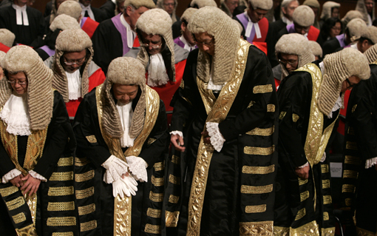
Review
Notes:
Write chapter 6 summary notes
Write an essay plan

Slide 45



Syllabus Dot Point
The court hierarchy, methods of statutory interpretation and the doctrine of precedent.
Notes:
Chapter 6

Slide 46
Activity
Prepare an essay plan for the following question:
The doctrine of precedent is one of the principles that underpins common law. Discuss its operation in the Australian courts.
Instruction
Highlight key words
Are there multiple parts to this questions?
What does the indicator want you to do?
Identify the key relevant points
What case examples will you tender as evidence, to illustrate your understanding?

